Slide 1
OpenMP: Basics of Parallel For
Laxmikant V. Kale
Some Slides based on Prof. David Padua’s lectures on OpenMP
© 2018 L. V. Kale at the University of Illinois Urbana-Champaign

Slide 2
Recap
OpenMP directives are expressed as pragmas
#pragma omp construct clauses..
Corresponding syntax exists for FORTRAN, another popular language for performance-oriented programming, especially in science and engineering
If directives are ignored by compilers, it is still (usually) a correct sequential program
I.e., the directives are only intended to help in speeding up the program by using multiple processors

Slide 3
parallel for Construct
Specifies that the iterations of the immediately following loop for loop (C/C++) may be executed in parallel
We haven’t introduced clauses yet
e1, e2 and e3 are expressions
Only a restricted form of for loop is allowed
The total number of iterations must be known at the start of the loop
And the incrementing (e3) and continuation (e2) conditions must be correspondingly simple
You cannot write a while loop in the form of a for loop (which C/C++ permits)
#pragma omp parallel for [clauses]
for (i = e1; e2; e3) {
body of the loop
}

Slide 4
Double Precision a*x + y (daxpy)
void daxpy(double *z, double a, double *x, double *y, int n) {
for(int i=0; i<n; i++)
{
z[i] = a*x[i]+y[i];
}
return;
}

Slide 5
Double Precision a*x + y (daxpy)
void daxpy(double *z, double a, double *x, double *y, int n) {
#pragma omp parallel for
for(int i=0; i<n; i++)
{
z[i] = a*x[i]+y[i];
}
return;
}

Slide 6

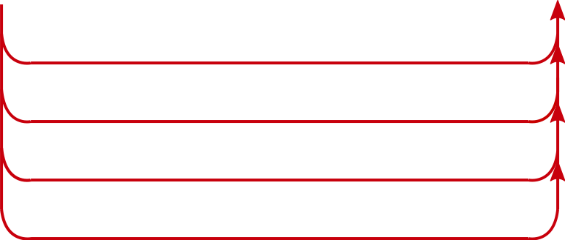

Parallel for: Execution
Master thread executes serial portion of code
Master thread enters saxpy function
Master thread encounters parallel for directive
Creates worker threads, and makes a team: workers + master
Parallel for
Master/Main Thread
Master thread resumes execution after the for loop
Worker threads disappear
Worker Threads
Team of Threads
Implicit synchronization: wait for all threads to
finish their allocation of iterations
Master and worker threads divide iterations of parallel
for loop and execute them concurrently
Notes:
Shall the image be animated before or after the mentioned points?

Slide 7
Number of Threads
You can control the number of threads OpenMP uses
Typically set equal to the number of cores (or SMT threads) or one less
Use an environment variable
Use omp_set_num_threads() function, to override the env variable
setenv OMP_NUM_THREADS 8 (on Unix with csh shell)
export OMP_NUM_THREADS =8 (with bash)
void saxpy(double *z, double a, double *x,
double *y, int n) {
omp_set_num_threads(8);
#pragma omp parallel for
for(int i=0; i<n; i++)
{
z[i] = a*x[i]+y[i];
}
return;
}

Slide 8
Loop Scheduling
Which thread will execute which iterations?
This is called the loop schedule
The default schedule assigns iterations to threads as evenly as possible (good enough for saxpy)
You can have more control over scheduling
As we will discuss later

